Slide 1


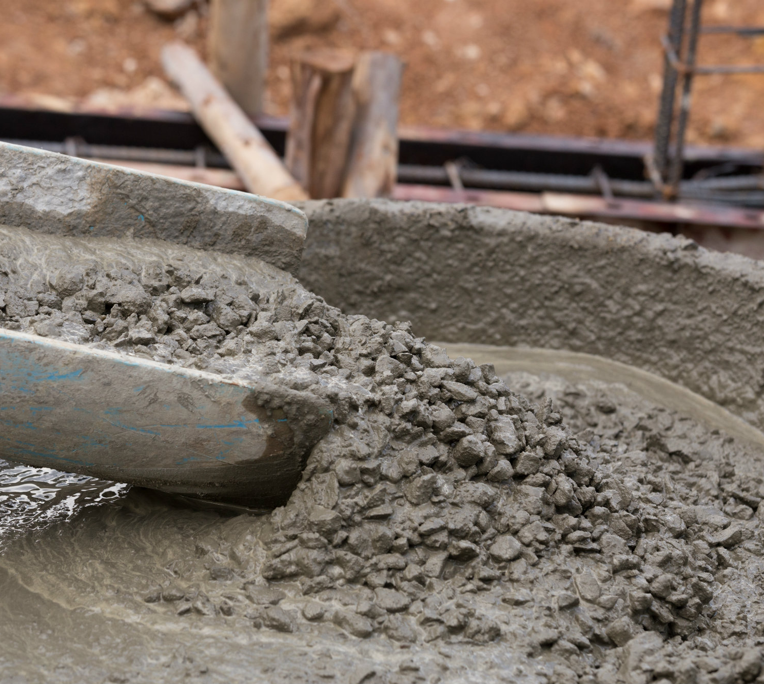
APPLICATION OF NANOPARTICLE IN CEMENTING OPERATIONS
NAME- RITAM BISHNOI (20PE3034)
UTKRASH SHUKLA (20PE3047)
MENTOR- Dr. SHIVANJALI SHARMA
ASSOCIATE PROFESSOR
DEPARTMENT OF PETROLEUM ENGINEERING AND GEO-ENGINEERING

Slide 2
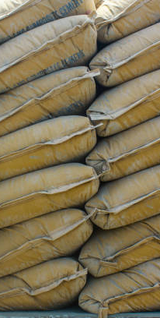
INTRODUCTION
Cementing wells play a crucial role in the exploration and completion of oil wells. Its primary objective is to establish effective isolation between different zones, ensuring mechanical integrity and support for the wellbore casing, and safeguarding the casing against corrosive fluid attacks.
By incorporating nanoparticles into the cement mixture, the water content is enhanced, resulting in a reduction of the settling process and an increased tolerance of the cement during the initial stages of cementation.

Slide 3
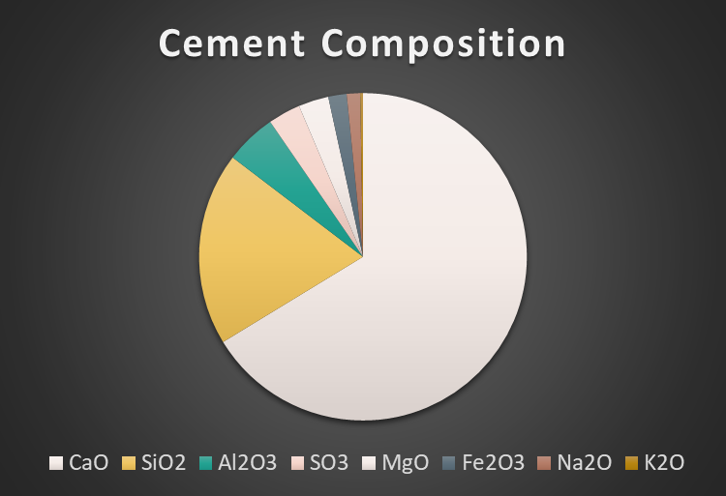
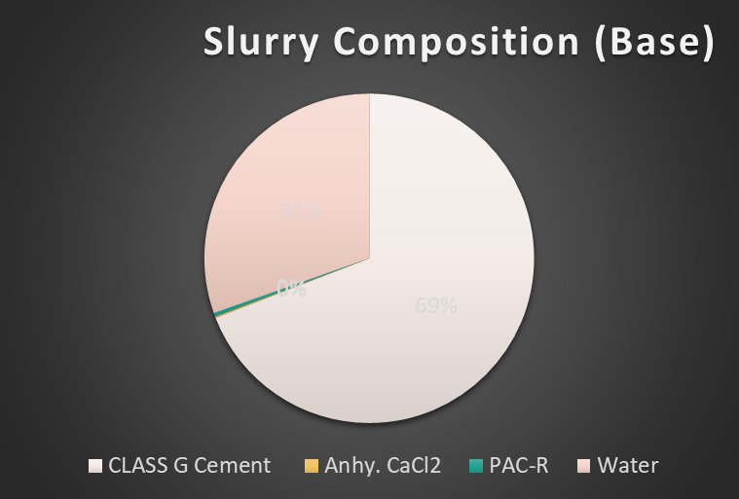
ABOUT CEMENT SLURRY

Slide 4
ABOUT PREVIOUS WORK
We had started our project in the month of August, 2022 by using cuttle bone fish as the nano particle for cementing application.
Then we changed the nano particle to Zinc oxide, it showed great improvement in cementing application than cuttle bone fish.
Later, we also use Silicon di oxide as nano particle in cementing application and compared the ZnO and SiO2 nano particle.
For the three Nano particles, we performed the Autoclave Experiment, HPHT Filter Test and Unconfined Compressive Strength (UCS).
The results of these experiment were acceptable for ZnO and SiO2 nano particle and therefore we had compare the two nano particles on basis of the fluid loss and compressive strength.

Slide 5
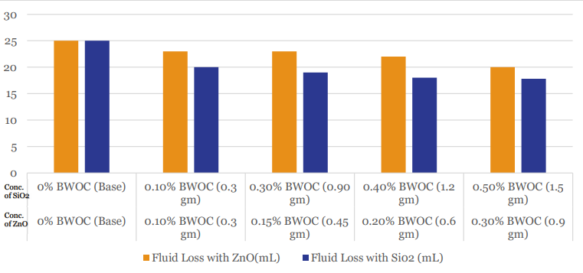
HPHT Results

Slide 6
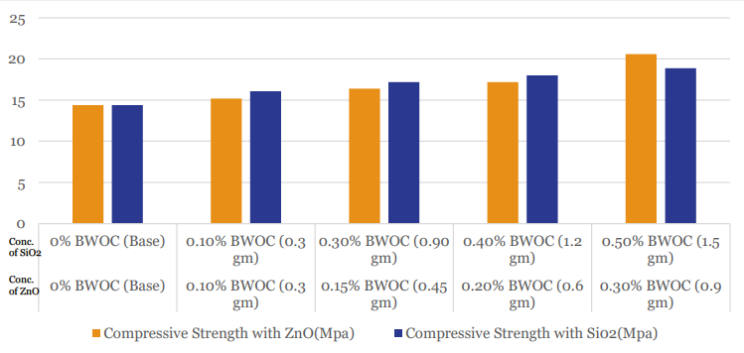
Compressive strength Comparision

Slide 7

HAMILTON BEACH MIXER
This time we had to make the cement slurry in the Hamilton Beach Mixer as the Waring Blender in which we used to make the cement slurry was not working.
It was a difficult task as Warrying blender was made for preparation of cement slurry whereas Hamilton mixer is used for drilling fluid.
It had 3 speed modes at 13000, 16000 and 19000 rpm.

Slide 8
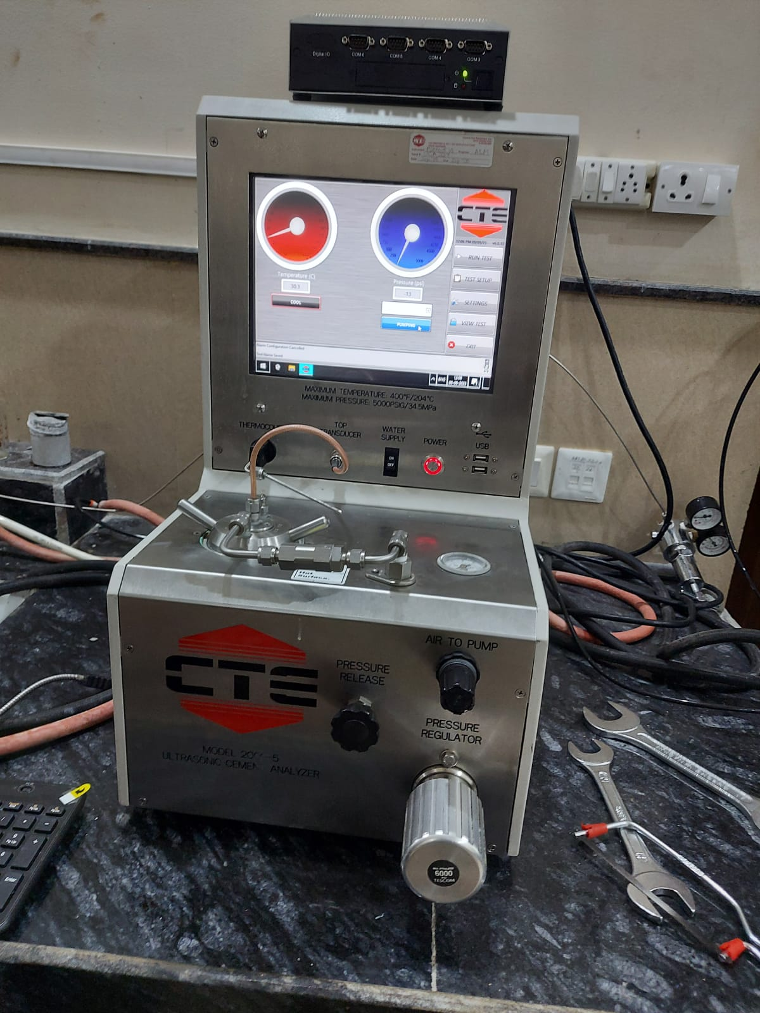
ULTRASONIC CEMENT ANALYZER
The theory of operation is based on the correlation between ultrasonic pulse velocity in the cement sample and its compressive strength. Strength indications are determined by measuring the change in velocity of an ultrasonic signal transmitted through the cement sample as it cures.

Slide 9

PRINICIPLE OF UCA
Generation of Ultra sonic waves
Transmitting the Ultrasonic waves
Propagation of Ultrasonic waves
Interaction with the cement
Receiving of echoes
Analysis in time of flight
Assessment of cement quality
Data interpretation

Slide 10
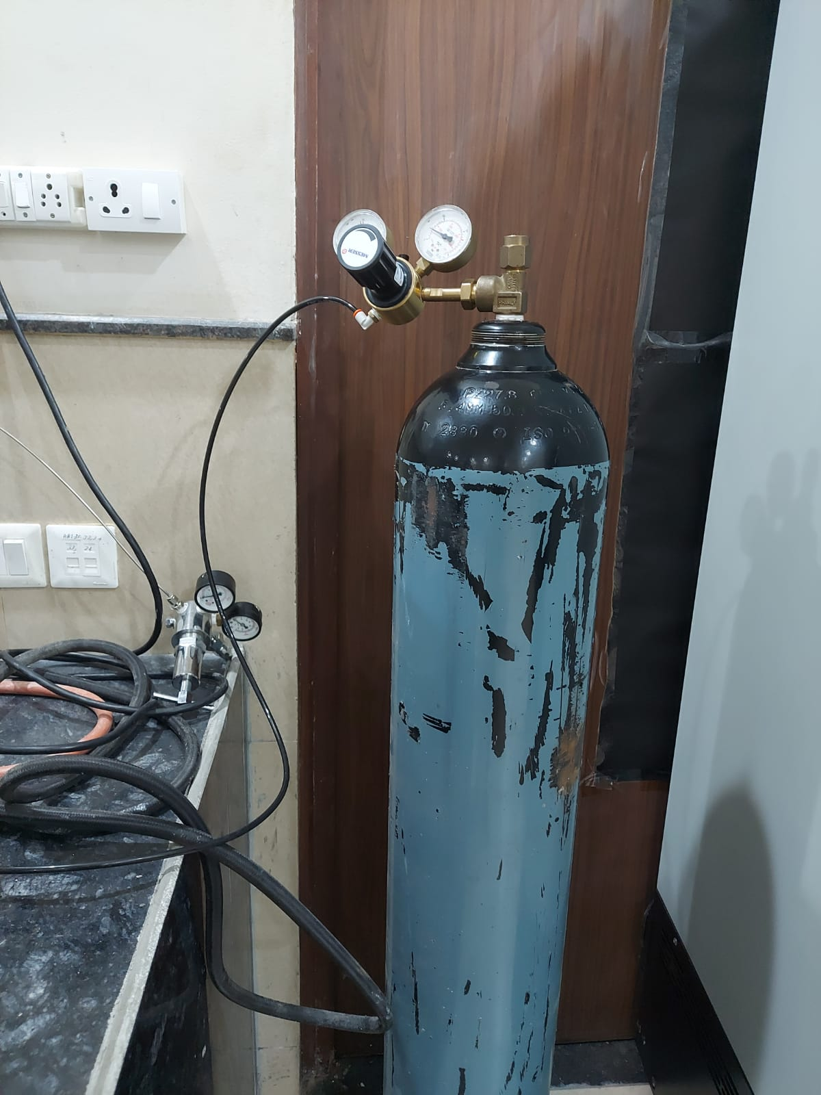
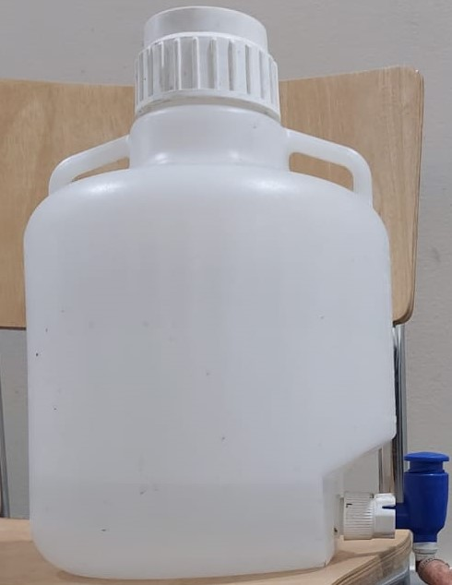
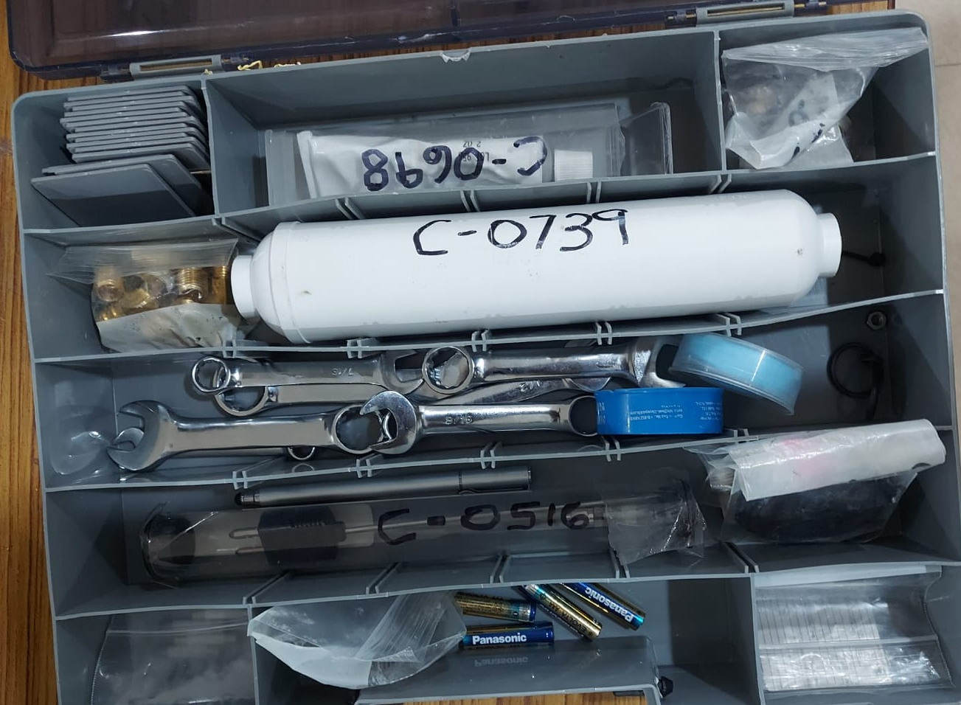
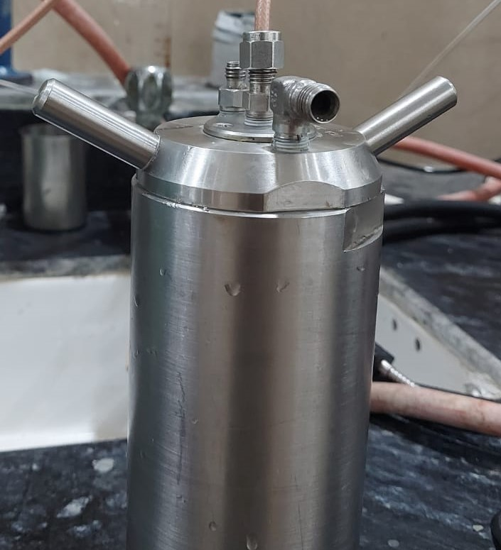
COMPONENTS OF UCA
UCA Cell
UCA Monitor
Water Tank
Gas Cylinder
UCA Tool Kit

Slide 11

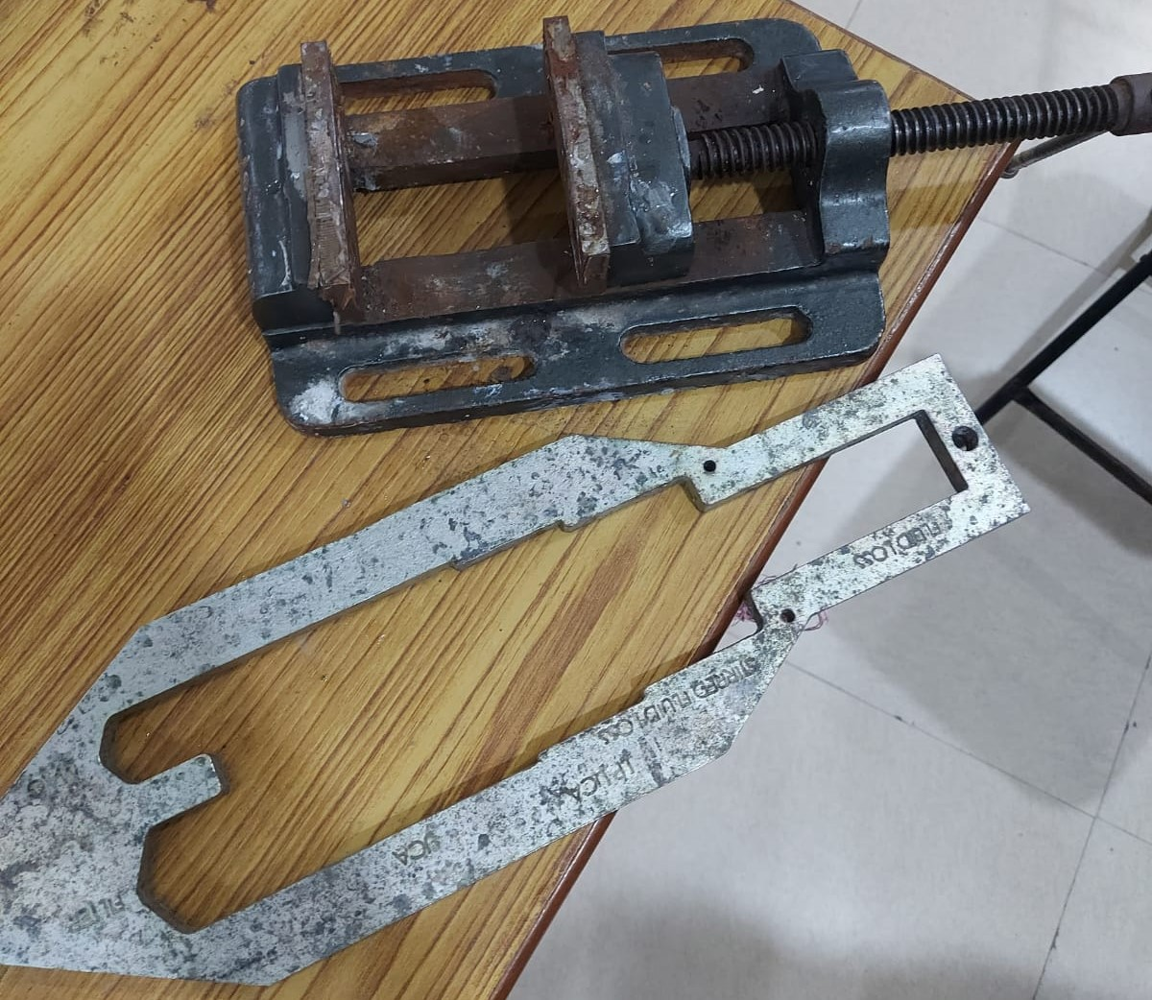
STEPS TO OPERATE UCA
First we had to apply the grease in the threads of UCA cell to maintain lubricity and to prevent threads from being stuck together as we are using cement slurry.
Then we fasten the lower part of UCA cell and then pour the cement slurry in the cell upto a certain level of a tool called key and then we fill the remaining cell with water and then fastening the top of UCA cell.

Slide 12
Then we need to make some connections to connect the top transducer, thermocouple and a U- shaped component to connect the cell with pressurized gas cylinder.
Later we need to open the gas cylinder valve for pressure to be applied on UCA Cell.
Then the most difficult task to perform in UCA was the setting of pressure regulator and air to pump knob. We had to set the pressure such that the pressure fluctuation range is minimal.

Slide 13
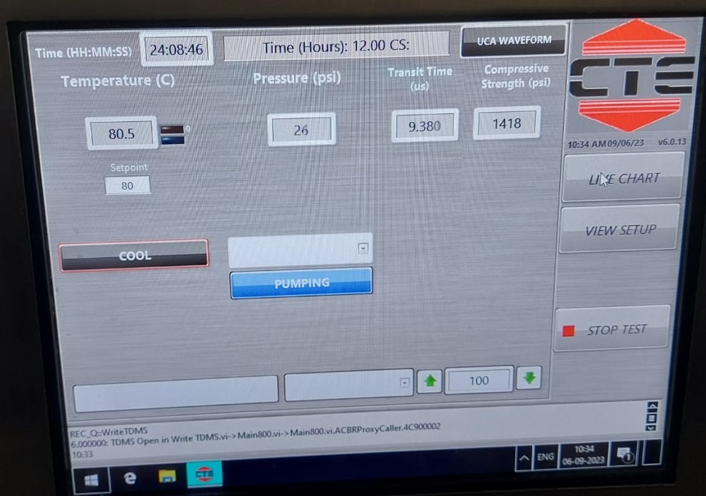
After doing that we had to set the settings in UCA. We set the ramp time for the temperature to reach 80 degree celsius within 4 hours and a soak time of 20 hours at a pressure of 500 psi.
After running the test we had to monitor the test for 4 hours until the temperature reaches 80 degree celsius.
The UCA keeps on recording the data of compressive strength, transit time, pressure and temperature with respect to time.

Slide 14
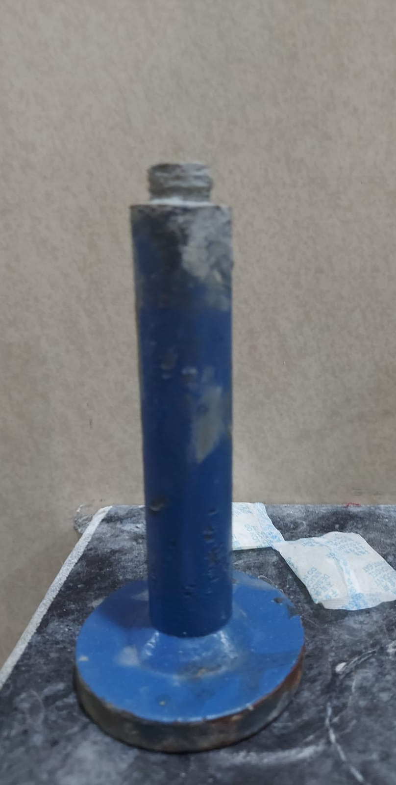
After 24 hours we stop the test by clicking on stop test Button.
And start the cooling button to cool down the UCA cell.
When temperature of UCA cell falls down to Room Temperature then we retrieve the cell and open it.
But since the cement was left for 24 hours the cement settles and becomes hard therefore we had to hammer the cement out of UCA cell.
Then cleaning of UCA cell was done so that there was no left over cement in the cell and in threads of cell.

Slide 15

FUTURE SCOPE
We made diligent efforts to operate the UCA system, but unfortunately, we encountered technical challenges that have thus far prevented us from obtaining the desired results.
While we have studied its working principles, we have yet to achieve successful outcomes in our testing.

Slide 16

CONCLUSION
ZnO and SiO2 have shown promising results.
PAC-R effectively reduces spurt loss.
SiO2 demonstrates superior performance in HPHT tests compared to ZnO.
ZnO provides higher compressive strength than SiO2.
We understand the working of UCA (Ultrasonic Cement Analyzer).
We are able to prepare cement slurry with Hamilton Beach Mixer also.

Slide 17

ACKNOWLEDGEMENT
We would like to extend our heartfelt gratitude to the Rajiv Gandhi Institute of Petroleum Technology for providing us with the necessary facilities and resources. Additionally, we would like to express our sincere appreciation to the Department of Petroleum Engineering and Geo-Engineering for their unwavering support throughout our journey.
We would also like to convey our deepest appreciation to Dr. Shivanjali Sharma for her invaluable guidance and unwavering encouragement throughout the project. Her extensive knowledge and expertise in the field of nano-particles and cementing operations have played a pivotal role in shaping our research ideas and helping us overcome any challenges we encountered.
This project has significantly expanded our knowledge and provided us with invaluable exposure to cementing operations and their applications in the oil and gas industry.

Slide 18
REFERENCES
[1] Sanaa Goyal, Pradeep Joshi, Rakesh Singh, Rohan, Applications and role of Nano-Silica particles on altering the properties and their usage for oil well cementing, DOI: 10.1016/j.matpr.2021.01.435
[2] Fahad Khan, Himanshu Kesarwani, Gaurav Kataria, Govind Mittal & Shivanjali Sharma (2022): Application of titanium dioxide nanoparticles for the design of oil well cement slurry – a study based on compressive strength, setting time and rheology, Journal of Adhesion Science and Technology, DOI: 10.1080/01694243.2022.2087963
[3] Alexander Anya, Hossein Emadi, Marshall Watson, Effect of size and shape of oil well cement test specimen on uniaxial compressive strength measurements DOI: 10.1016/j.petrol.2020.107538
[4] Robert F. Mitchell Stefan Z. Miska, Fundamental of Drilling Engineering, SOCIETY OF PETROLEUM ENGINEERS, Chapter 4: Cementing (Page No. 139-178)
[5] Salaheldin Elkatatny, Mohamed Mahmoud, Hisham A. Nasr-EI-Din,Filter Cake Properties of Water-Based Driiiing Fiuids Under Static and Dynamic Conditions Using Computed Tomography Scan DOI: 10.1115/1.4023483

Slide 19
REFERENCES
[6] Shivshambhu Kumar, Achinta Bera, Subhash N. Shah, Potential applications of nanomaterials in oil and gas well cementing: Current status, challenges and prospects, DOI: 10.1016/j.petrol.2022.110395
[7] Petro Ezekiel Mabeyo a,b , Yusra Salmin Ibrahim a , Jun Gu, Effect of high metakaolin content on compressive and shear-bond strengths of oil well cement at 80°C, DOI: 10.1016/j.conbuildmat.2019.117962
[8] Hussian Rabia, Well Engineering and Construction, Chapter 6 Cementing (Page No 201-264)
[9] American Petroleum Institute, Recommended Practice for Testing Well Cements, API Recommended Practice 10B-2 Second Edition, APRIL 2013 (R2019), 2013.
[10] P. Souza, R. Soares, M. Anjos, J. Freitas, A. Martinelli, D. Melo, Cement slurries of oil wells under high temperature and pressure: the effects of the use of ceramic waste and silica flour, Brazilian J. Pet. Gas. 6 (2012) 105–113. DOI: 10.5419/bjpg2012-0009

Slide 20


